Slide 1
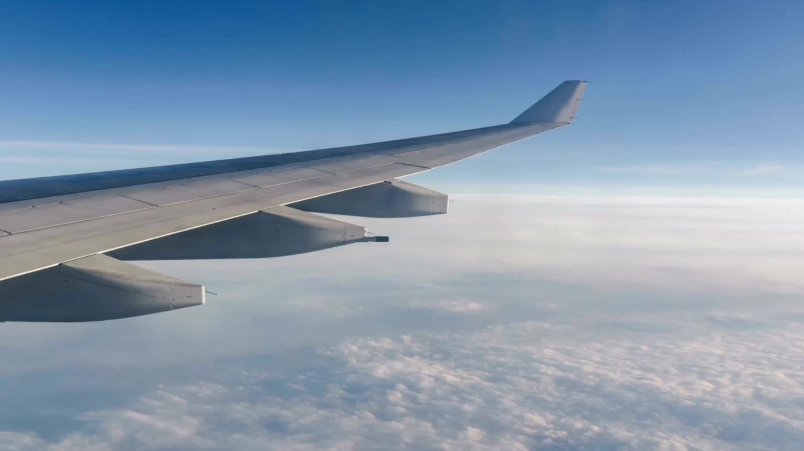

Airlines- Still safe to fly?
Debasish Panda

Slide 2

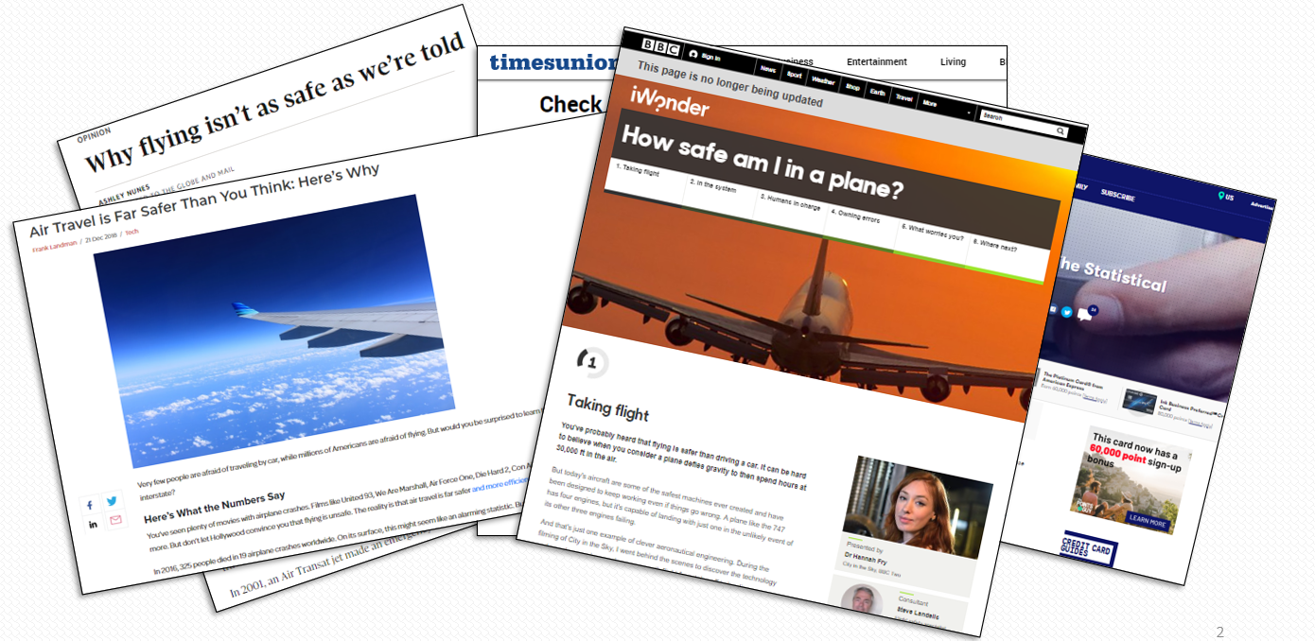
The perception

Slide 3
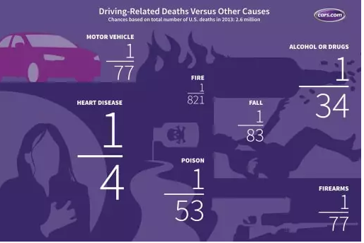
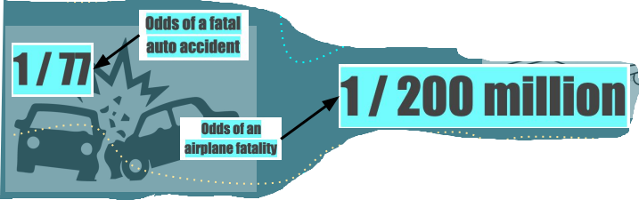
Driving and other related deaths Versus Aviation related deaths
Source: Are the Odds Ever in Your Favor? Car Crashes Versus Other Fatalities | Cars.com

Slide 4
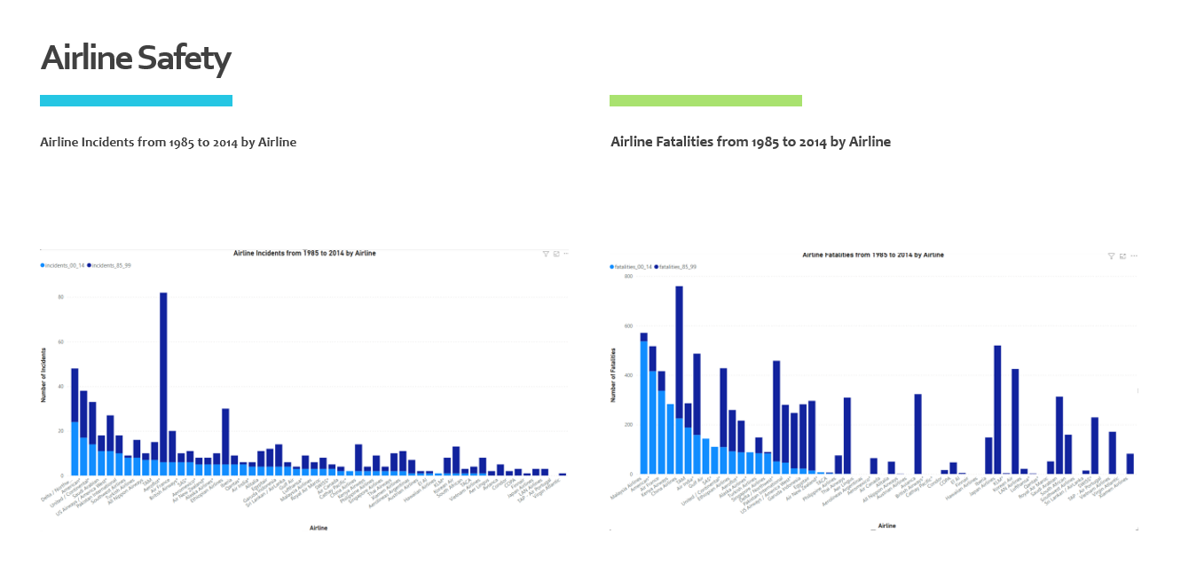
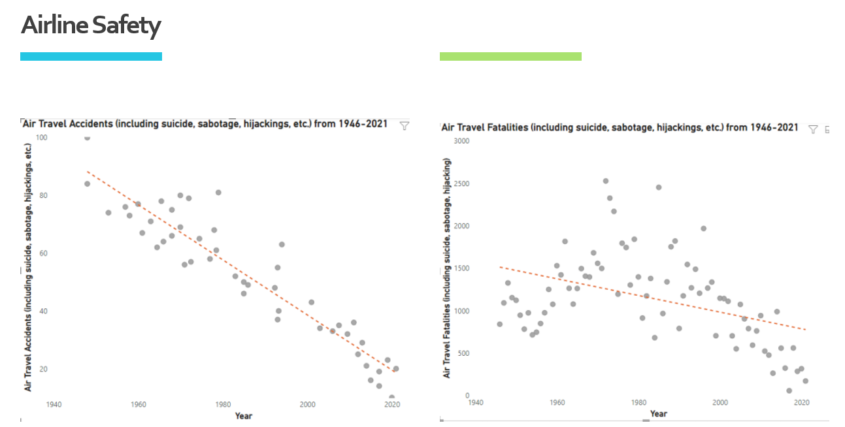

Slide 5
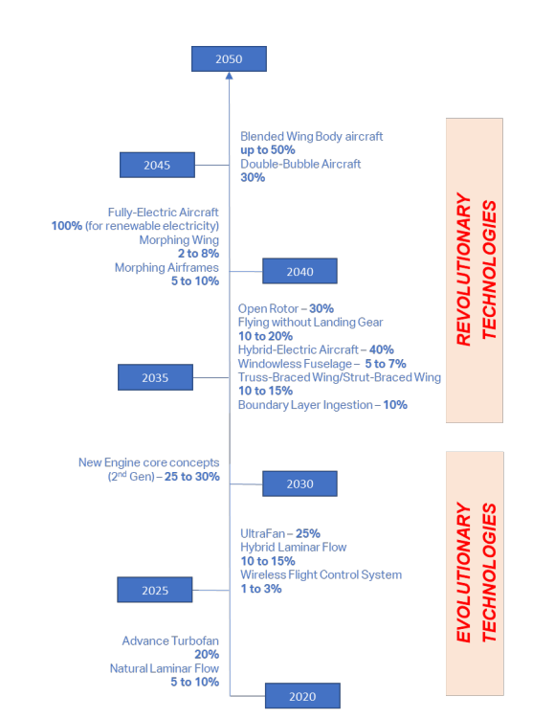
Time-line showing the implementation of fuel-efficient and greener technologies to make the air travel safer and more economical
Source: https://www.iata.org/contentassets/8d19e716636a47c184e7221c77563c93/Technology-roadmap-2050.pdf

Slide 6

Thank You!

